Slide 1
Data Transmission : How Data Travels Across Devices
Presented By : Vikas R. Joshi

Slide 2
Introduction
Data Transmission refers to the process of transferring data between electronic devices.
Transmission can occur through wired media (such as Ethernet cables) or wireless technologies (such as Bluetooth and Wi-Fi).
It is commonly used in applications such as email communication, video conferencing, web browsing, and file sharing.
The process is governed by network models and relies on standard transmission protocols to ensure reliable and efficient data exchange.

Slide 3
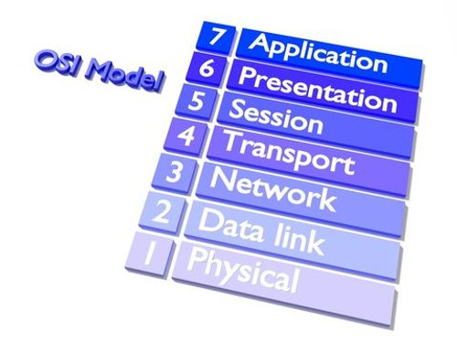
OSI Model
7-layer reference model for data communication.
Layers: Application → Presentation → Session → Transport → Network → Data Link → Physical
Each layer adds or removes information to manage communication.
Standardizes data exchange across different systems and networks.

Slide 4
Sender to Receiver – Data Flow
Sender: Data flows from Application layer down to the Physical layer.
Physical Layer: Transmits bits over the communication medium.
Receiver: Bits flow from Physical layer up to the Application layer.
Example: Sending an email or file across a network.

Slide 5
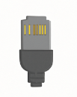

Transmission Media
Wired: Ethernet, Fiber Optic, Coaxial – High speed, stable connection
Wireless: Wi-Fi, Bluetooth, Infrared – Portable, flexible
Media type affects speed, reliability, and interference.
Choice depends on range, cost, and performance requirements.

Slide 6

Data Encapsulation & Decapsulation
Data is split and wrapped with headers at each OSI layer.
Units: Bits → Frames → Packets → Segments → Data
Encapsulation occurs at the sender; Decapsulation at the receiver.
Each layer processes only its specific header.

Slide 7
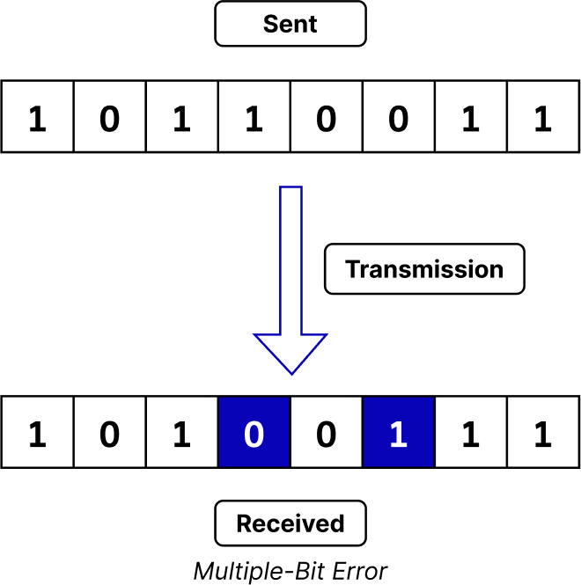
Error Correction & Detection
Errors may occur due to noise or interference.
Common techniques: Parity Bits, Checksums, CRC (Cyclic Redundancy Check).
Ensures reliable and accurate data delivery.
Used in file transfers, streaming, and network communication.

Slide 8
Transmission Modes
Full-Duplex: Both devices send and receive simultaneously (e.g., telephones).
Half-Duplex: Devices take turns to send data (e.g., walkie-talkies).
Simplex: One-way communication only (e.g., keyboard to PC).
Full-duplex is faster, while half-duplex is simpler.

Slide 9
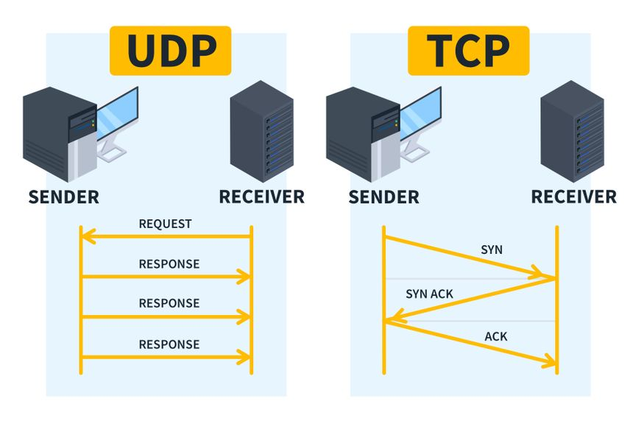
Transmission Protocols & Security
TCP: Reliable, ordered, and error-checked data delivery.
UDP: Faster, but no delivery guarantee (used in streaming/gaming).
Encryption Protocols: HTTPS, SSL/TLS ensure secure data transfer.
Firewalls and VPNs protect against external threats.

Slide 10
Thank You

